Slide 1
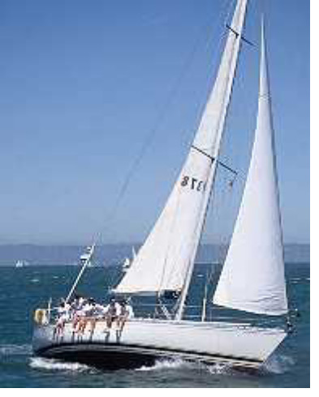
Learning To Sail

Slide 2
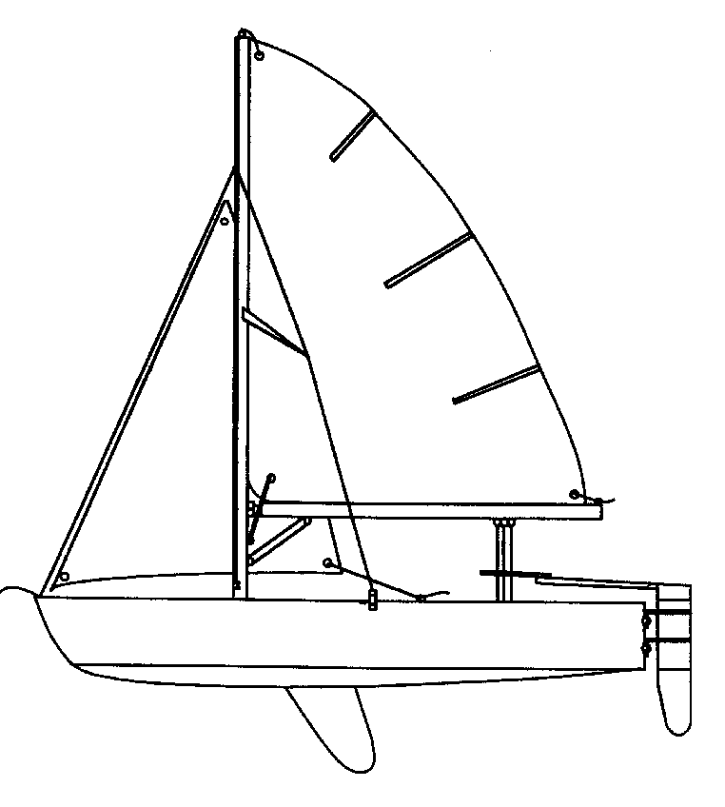
Parts Of The Boat - Hull
Tiller
Extension
Tiller
Bow
Stern
Gunwale
Transom
Painter
Hull
Pintles
Gudgeons
CenterBoard
(Daggerboard / Keel)
Rudder
Waterline
Plug

Slide 3
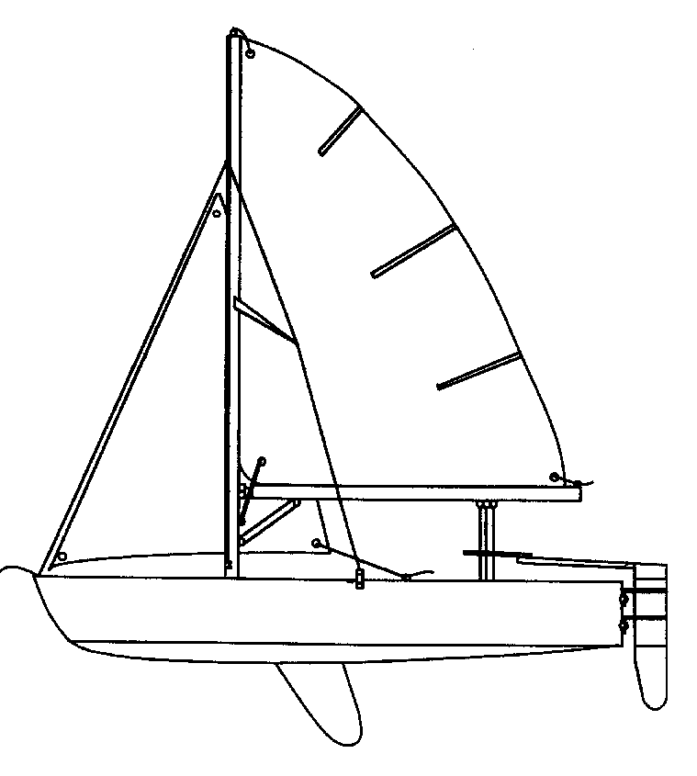
Parts Of The Boat - Sails
Head
Batten
Main Sail
Jib
Luff
Leach
Foot
Tack
Clew
Telltales
Grommets

Slide 4
Parts Of The Boat - Rigging
Standing
Running
Mast
Halyard
Boom
Spreader
Forestay
Cunningham
Shroud
Jib Sheet
Outhaul
Gooseneck
Main Sheet
Chainplate
Boom Vang

Slide 5
Clothes and Equipment
Dress warmly
  Layer, Layer, Layer !!
  It often seems colder at the lake than here
  Bring extra clothing - You WILL get wet !
Sunscreen
Life Jacket’s
  One for every person on the boat - MANDATORY

Slide 6
Anything Else?
Meetings every Thursday @ 7:30
Mailing List - sailing@list.gtsailing.org
Web Page – www.gtsailing.org

